Slide 1

Data Exploration on Yelp
Group 13:
Li-Hsin Chang, Lei Han, Yutian Luo, Zhonghao Li, Xiaoyou Zhou

Slide 2
Introduction
Dataset:
Source: Kaggle
Content: 5.2 million user reviews of 174,000 businesses in 11 metropolitan areas in four countries (focus on Nevada restaurants data)
Goal:
To improve Yelp’s services for its users
Notes:
Hayley

Slide 3
Data Cleansing
Data importing
With large dataset, we have to define data type schema to speed up data importing.
Data merging
Large dataset results in memory-painful data merging, we have to be careful in case of out-of-memory errors.
Notes:
Zhonghao
so we have yelp review data which sizes 3.53 gigabytes, and yelp user, sizes 1.2 gigabytes, overall we have data covering establishment information, user, review business attributes and others, which sizes over 5 gigabytes, it has caused a lot of problems when we imported data to our environment and merged together to analyze. In this case, we made datatype schema to boost the read on yelp review, we also made chunks for review data, imported with filtering so as not to use up too much of our memory.

Slide 4
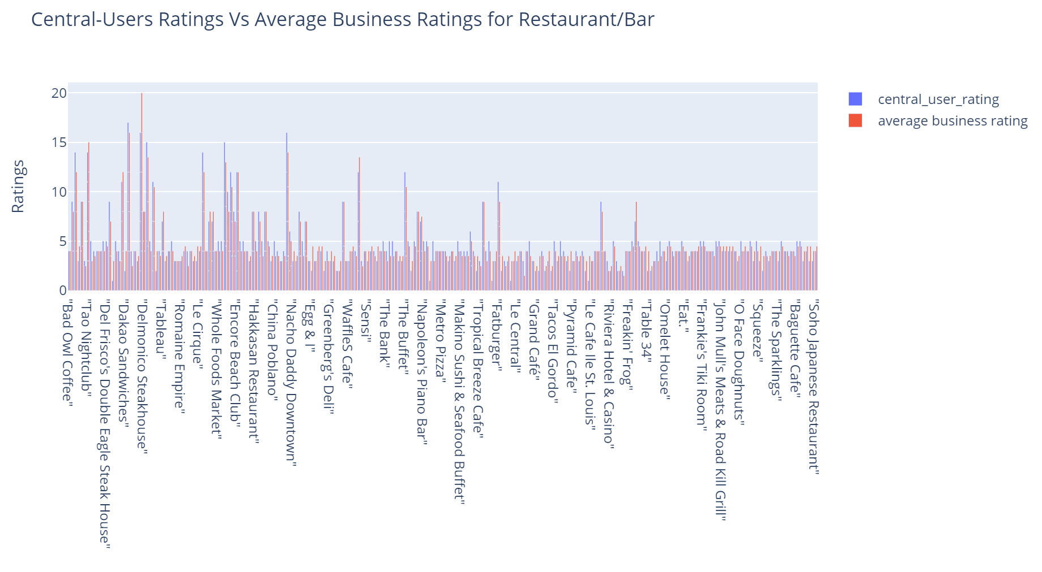

Users
Findings:
The ratings given by central users are slightly higher than the corresponding restaurant average ratings.
People who have more fans on Yelp tend to overrate the restaurants.
Fans tend to read central users’ reviews for suggestions.
Restaurants might pay central users to write better reviews.
Recommendations:
Yelp can develop some mechanisms to increase the authenticity of reviews.
Give “medals” to central users whose ratings are close to the real restaurant average ratings.
More “medals”, more trustworthy the reviews!
Notes:
Xiaoyou
Certain reviewers have more friends who are also active on the review platform, so we define them as “central users”. We want to know how the average rating given by central users correlates to the true restaurant average rating.(In other words, are the values of these users’ ratings close to average restaurant ratings? To realize this, we sorted users data at a descending order by their number of fans on Yelp and choose the first 10% as central users. Then we plotted a dynamic multi bar chart to show the comparison between ratings given by these central users and the corresponding restaurant average ratings. From the result we can see that the ratings given by central users are slightly higher than average business rating, which indicates that people who have more fans tend to overrate the restaurants. Taking into consideration the fact that people tend to read central users’ reviews for suggestions, restaurants might pay central users to write better reviews.To increase the authenticity of reviews, Yelp can develop some mechanism such as giving “medals” to central users whose ratings are very close to the overall restaurant ratings. More “medals” users have, more trustworthy their reviews are !

Slide 5
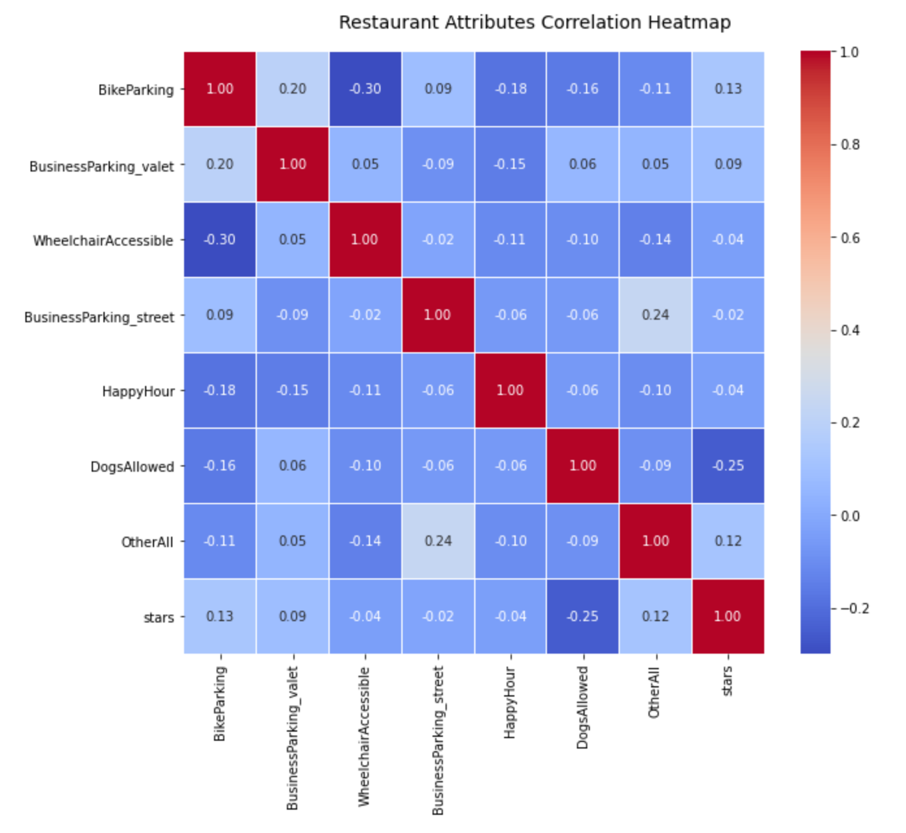
Restaurants
Get correlation heatmap
“Dogs Allowed” has highest negative effect, “Bike Parking” has highest positive effect
Correlation among attributes is low, so we can simply apply linear regression to build our model
Generate Prediction Model
y=3.47+0.13*x1+0.14*x2-0.10*x3-0.23*x4-0.11*x5-0.92*x6+0.23*x7
Application
Yelp can give a new joining restaurant a new tag called “OVERRATED” or “FUTURE STAR” by comparing stars calculated by our model with the actual star.
Yelp can give those restaurants with special attributes like “Dogs Allowed” a virtual medal like “GOOD OWNER” to encourage them.
X1
X2
X3
X4
X5
X6
X7
y
Notes:
Yutian
Next we turn to restaurant perspective. Yelp allows users to search restaurants based on tags, which is also an important indicator for yelp users to decide which restaurants to go. In order to better analyze the impact of these tags, also known as the restaurants’ attributes, we only keep 6 attributes appear more than 500 times and put other 75 attributes in OtherAll. Then we create a correlation heatmap and found that “dogs allowed” have highest negative effect, “bike parking” have highest positive effect. And Correlation among attributes is low, so we can simply apply linear regression to build our model.
Here is our model, and among all attributes, “dogs allowed” have highest negative coefficient and “business parking valet” have highest positive coefficient, which consistent with our correlation heatmap.
Based on this model, we have 2 recommendations to yelp: first, For a new joining restaurant, by comparing stars calculated by our model with the actual star, yelp can give this restaurant a new tag that is “OVERRATED” or “FUTURE STAR”.
Second, According to our model, simple attributes like “bike parking” and “business parking valet” are more likely to benefit restaurants star rating; special attributes like “wheelchair accessible” and “dogs allowed” tend to decrease the restaurants’ star rating. These special tags invisibly raises users’ expectations for restaurants, resulting in users tending rating lower. For those restaurants, Yelp can give them a virtual medal “good owner” to encourage them and make up for the risk of adding these tags.
Let’s cindy talk about review part.

Slide 6
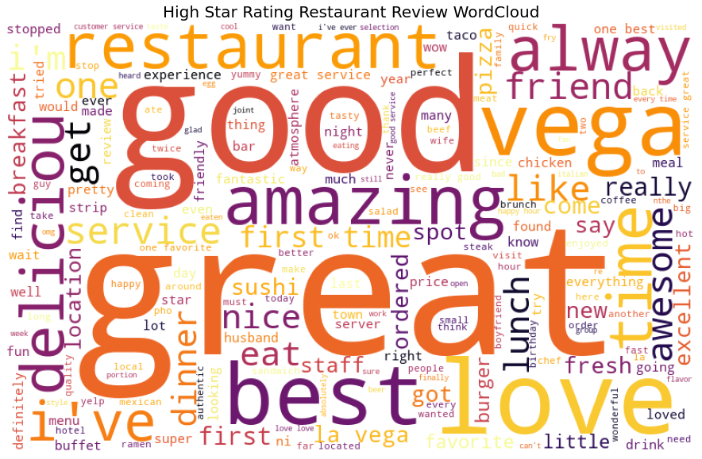
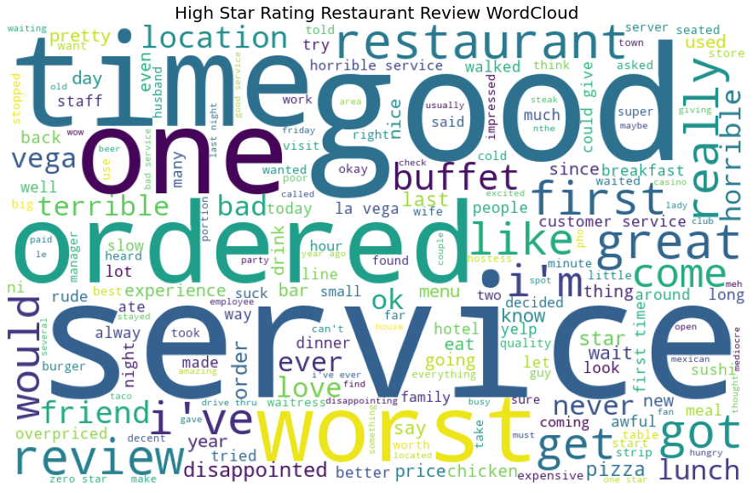
Review
High star rating Reviews
Common
Low star rating Reviews
sushi/ramen
breakfast/brunch
Steak
Burger
taco
service/experience
Price/expensive
location/spot
atmosphere
Buffet
Bar
Lunch
Notes:
Cindy
In the third part, let’s dive into review analysis to help Yelp improve the review system and user experience.
How can restaurant owners and users quickly extract information from reviews? Which aspects of the restaurant experience do people mention in reviews when they rate restaurant 4 or 5 stars compared to 1 or 2 stars? We plot high star review and low star rating review wordclouds. Interestingly, an important indicator that makes people rate few stars is not about food, but service instead, as service frequently mentioned in reviews. While in high-star reviews, a common word is “delicious”, describing the dishes.
Several common topics people care a lot about are service, pricing, location, and atmosphere. More holistic rating system where users can rate on these aspects separately.
Furthermore, currently Yelp only have food category tags on the restaurants, so we would highly recommend that Yelp extract keywords in reviews like in our wordcloud, and tag the restaurants so that users browsing the site can quickly get a gist of what most users are saying about their experience here.
-------------------------------------------------------------------------------
It’s interesting that restaurants that serve Japanese food or breakfast/brunch seem to get higher star ratings and that buffet or bars seem to be receiving low star ratings.
While in five-star reviews, the most common words are “best”, “love”, and “delicious”, which tend to describe its dishes or whole restaurant. Surprisingly, the service of the restaurant is the foundation of the restaurant. On top of this, the delicious dishes will add points to the restaurant. ...
Yelp can provide a new service "customized word cloud" to restaurants to help restaurants better analyze what their customers like and what areas the restaurant needs to improve. ...

Slide 7
Review
Correlation between review sentiment score and star rating
Generally, review star increase, review sentiment increase. Some discrepancy may be cause by sentiments for different aspects of the restaurants
Classification Model LSTM
Predict likely average review star rating for new restaurants with few review ratings
Review Text
Review Star Rating
Multiclass
classification
Remove contradicting instances
Remove stopwords
Tokenize
Transform text to padded sequences
Build Bidirectional LSTM model
Compile and train
Fit and predict multi-classification problem
Accuracy on test data: 68.78%
Actions To Take:
Introduce granular rating metrics: food quality, cleanliness, service, atmosphere so that users can express different opinions in different areas
Notes:
Li Zhonghao
Credibility is the basis for yelp to become an excellent referencing app in the industry. Fair ratings help customers choose the ideal restaurant and attract more users, in turn, yelp can also help restaurants to improve through user feedback, through which they together constitute abundant echosphere. Whether users' ratings can truly reflect their dining experience is critical.
In this part of research, our goal is to justify a credible average star rating score and make restaurant recommendations for Yelp customers.
We used LSTM model to predict potential star ratings of newly opened restaurants when they have too short rating history, we used sentiment scores, (a score range from -1 to 1 reflecting user emotion based on the review texts,) to help us filter out abnormal reviews, where average sentiment in the review contradicted to the review star rating.
Other than this, we trained our sentiment scores by comparing it with restaurants’ stars and get rid of useless words in our word bags. (可以的) So we can apply our model in star prediction, especially in giving all fair star for those new restaurants with few star rating, after tokenized and padded texts, built and trained the model, we achieved approximately 69% prediction accuracy on both validation and test data. （简单讲一下怎么处理的就行）
We assume that this might caused by users do not have same rating metrics. In order to get a fair rating, Yelp can split matrics, for example, users can rate dishes, service and environment separately. …（这里可以不讲，老师问了再说）
讲吗 这里的逻辑改成这样，LSTM模型是拿来预测未来新餐厅的评分的。然后sentimentscore是辅助预测star rating的，sentiment如果和均值差很多，那就去掉那些数据啥的
我模型那里再改改，不花时间 主要现在预测评分的话我那一坨讲过了 你这个的目的就得明确 我当时是想说这里可以让yelp生成一个辅助打分机制 因为有不吻合 人们的评论和打分 所以我们可以帮助yelp设定一些metric 帮助打分
然后因为sentiment的判断情感的方式是bag 偶发
word，不管词出现的位置和顺序，导致负情绪比较少

Slide 8
Recommendations
For Users
Give “medals” to users.
For Restaurants
Create new tags based on the predicted star ratings.
Give a virtual medal to encourage restaurants.
For Review
Introduce granular rating metrics.
Implement real-time updated tags.
Provide review text analysis visualizations for restaurant owners.
Notes:
Hayley
For Users
Yelp can give “medals” to central users whose ratings are close to the real restaurant average ratings.
For Restaurants
Yelp can give a new joining restaurant a new tag called “OVERRATED” or “FUTURE STAR” by comparing stars calculated by our model with the actual star.
Yelp can give those restaurants with special attributes like “dogs allowed” a virtual medal like “GOOD OWNER” to encourage them.
Review system:
1. Introduce granular rating metrics: food quality, cleanliness, service, atmosphere so that users can express different opinions in different areas.
2. On the frontend, implement real-time updated tags that reflect topics users mentioned in reviews, such as “fresh”, “family friendly”, “good service”, 3. On the backend, provide text analysis visualizations for restaurant owners, so that they can quickly understand what customers are talking about in the reviews.

Slide 9
THANK YOU!

